Slide 1

Property and Rental management Web application
Bhuvan Chennoju
Hemanth Sai Bandi
Manjusha Namburi
Shravya Kanchi

Slide 2
Motivation for the Project
A Man travels the world over in search for
What he needs and returns home to find it.
– George A. Moore
New place
Community
Time Consuming
Legal issues
Trusting
Maintenance
Affordable
Friendly
Manual searching
Contracts
Lot to Research
Unknown area
What we did?
Build a web application to handle Most of the Issues for Renting and managing a home at one place.
Problem?
What?
Why?
How?
All-In-One
Application
Thing We Consider
Hurry! Solution!!

Slide 3
Flow of the Application
Technology Stack – MERN Stack
CSS
HTML
React
M – Mongodb
E – Express js
R – React js
N – Node js
Property Database
Web Application
Property on listing
Tenant Access
Administrative Access
New Search
Front End
Tenant Database
Mongodb
Express
Node
Back End

Slide 4
Data Used and APIs
APIs Tried to use for the Project
Mashvisor – Best for Airbnb & Rental Properties
Realty Mole – Best for overall Real Estate Data
Data about Property
Price
Area
Bedrooms
Availability
Safety & Tenant Friendly
Location
Data about Tenant
Name
Age
Contact
Mail id
Apartment
Rent Details
Mostly Manual Populated Data is used to fill the Placeholders, and Referenced from Macapartments site
Client-Server Communication : Mail to Admin Staff expressing the Interest

Slide 5
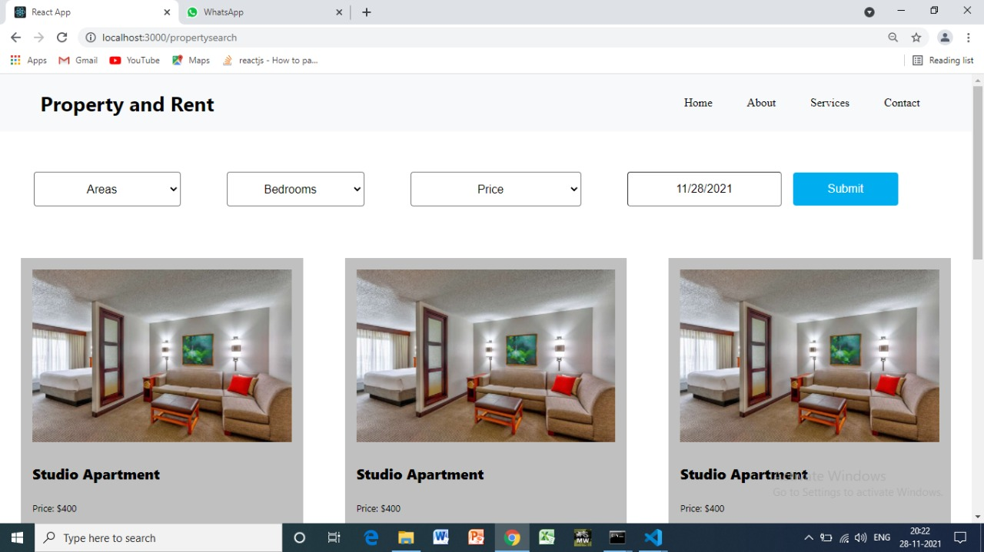
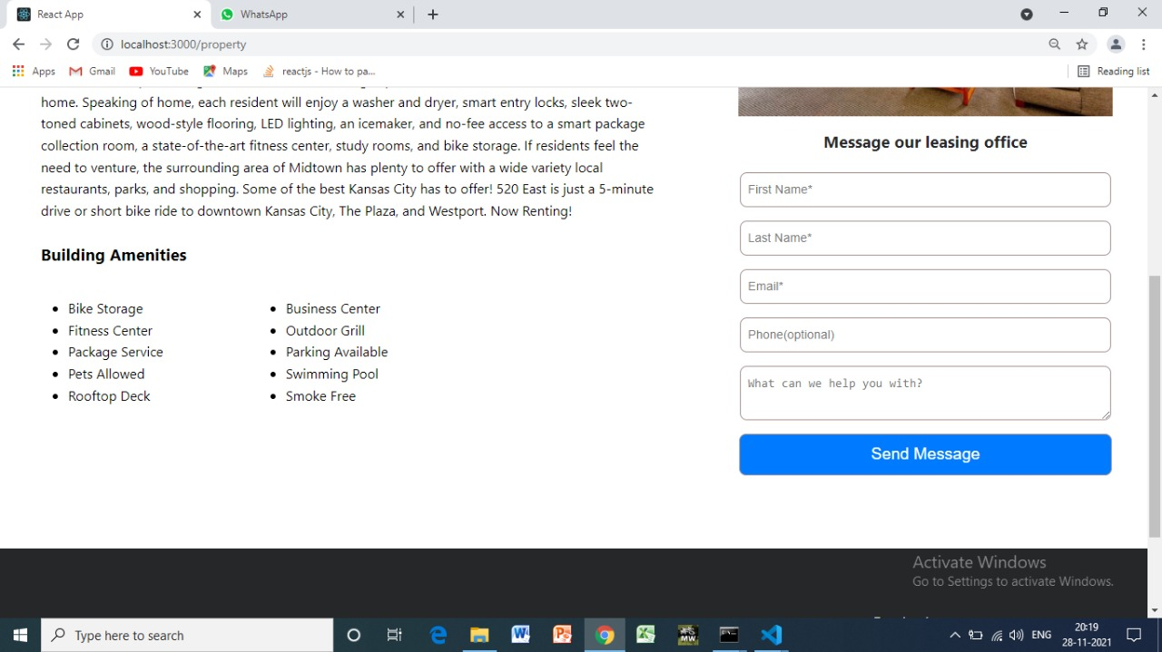
Final Demo
Home Page
Property Description and Interest Form

Slide 6
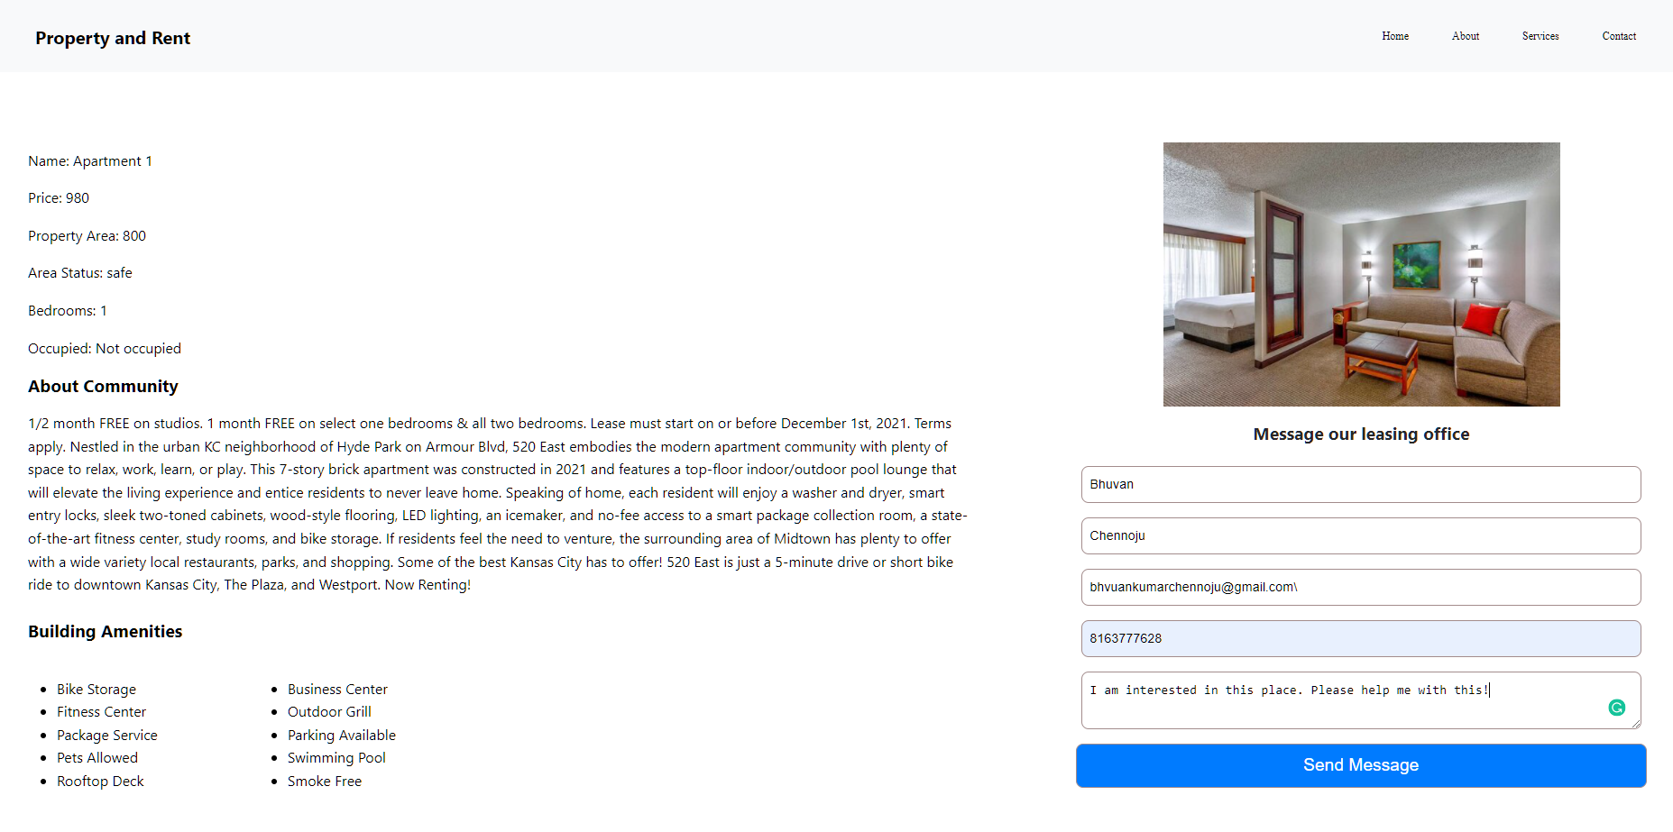
Property Details and Contact Form

Slide 7
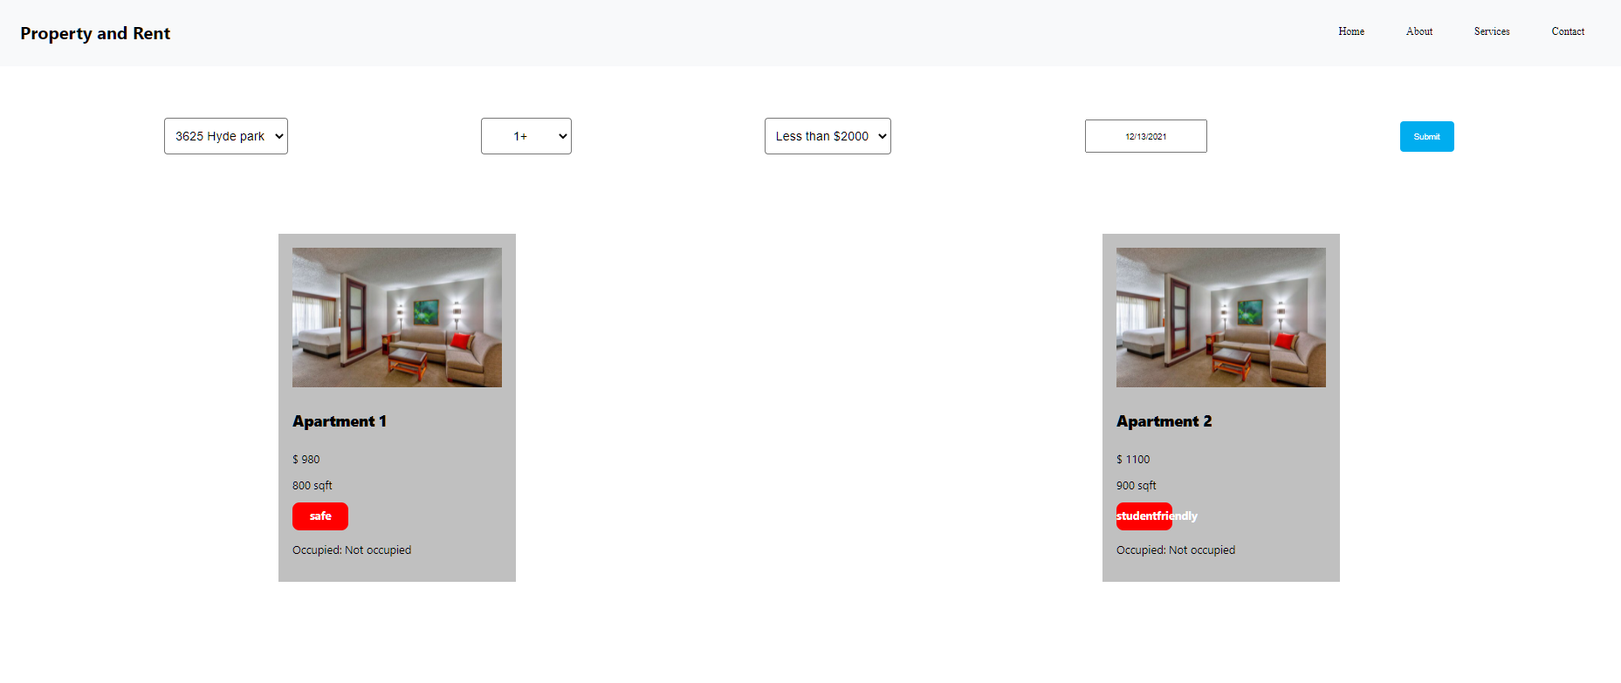
Property Listing on Website

Slide 8
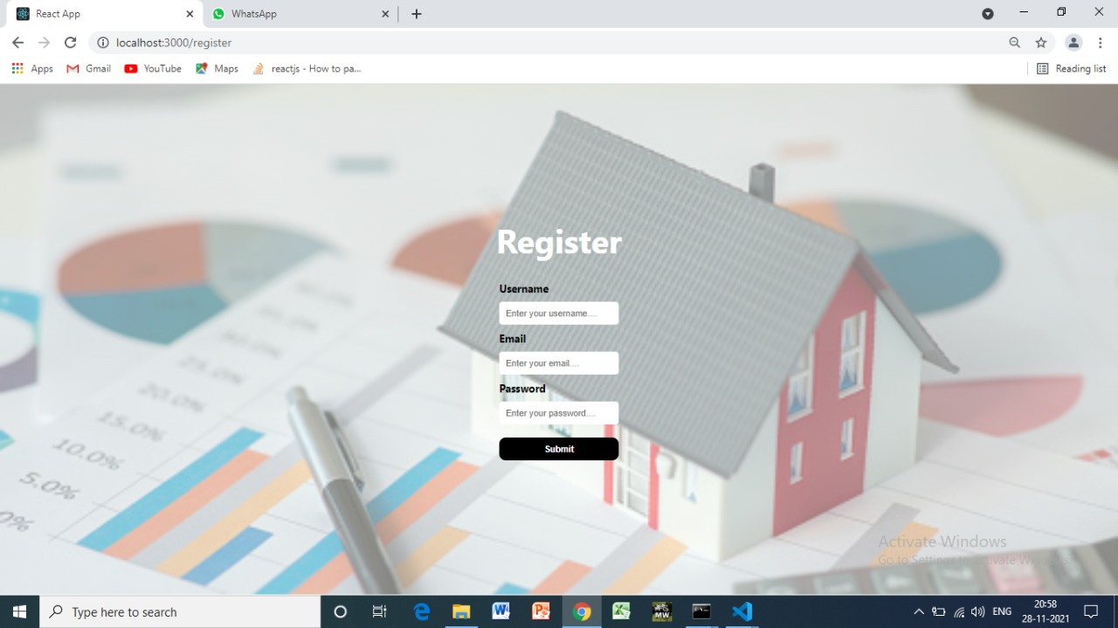
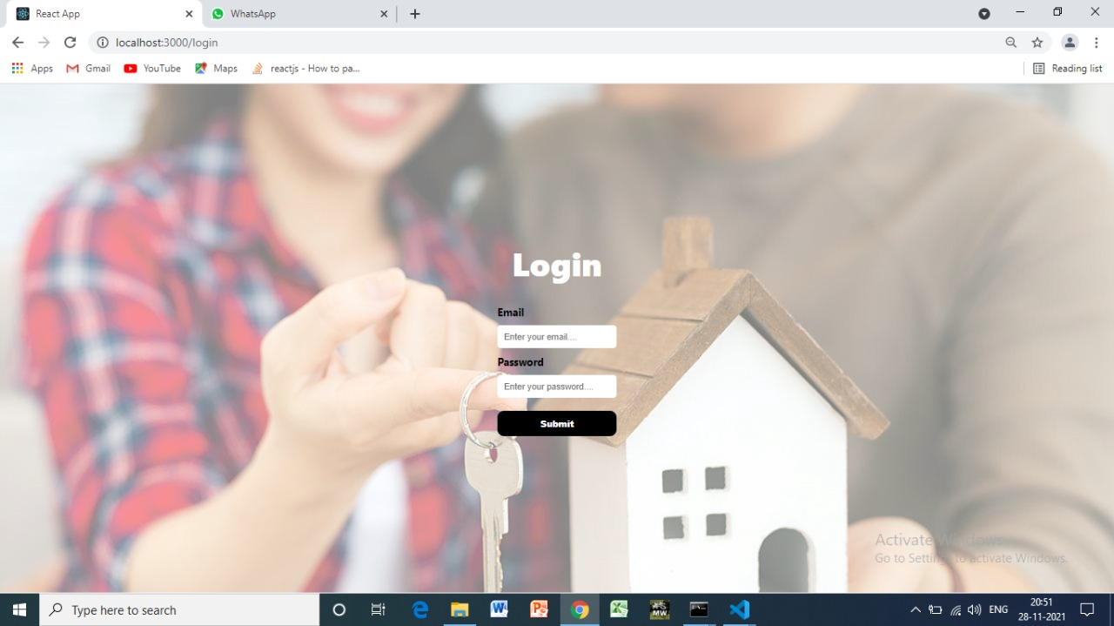
User and Admin Accesses
User Registration
User Login

Slide 9
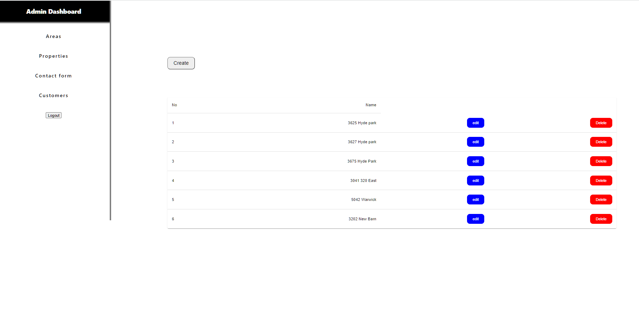
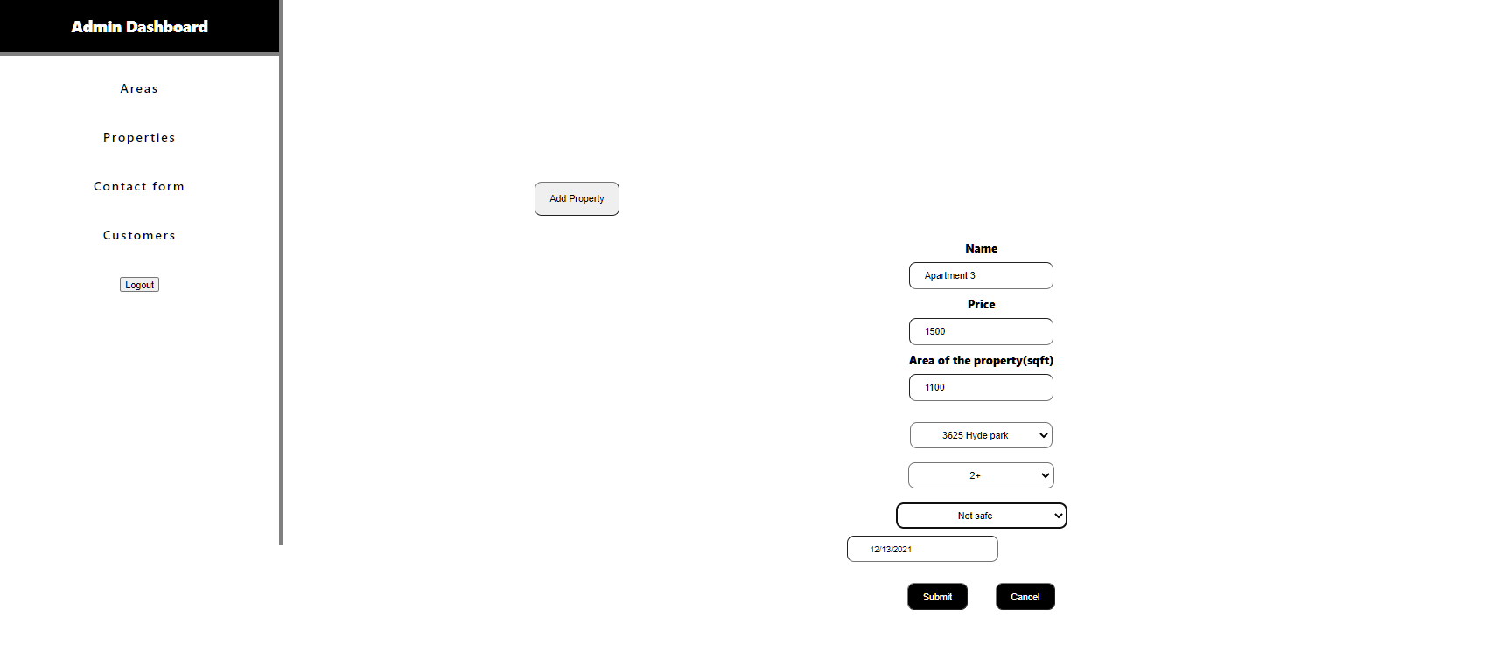
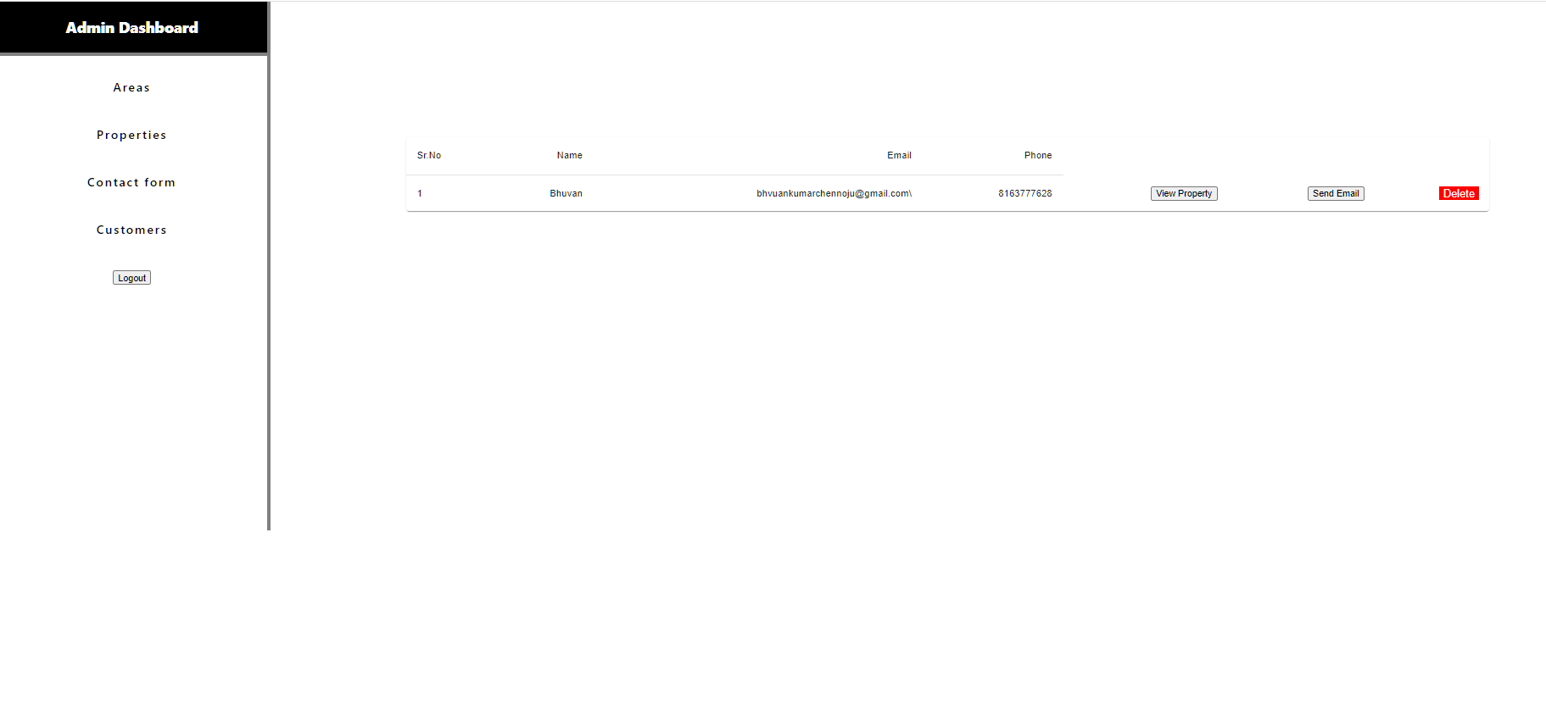
Administrative Dashboard
Area Creation and List
Property Details addition
Contact Forms from Customers

Slide 10
Blockages and Share of Work
Blockages:
Attempted to automate the data filling with the APIs, but unable to get the accurate data required for the application.
Haven’t Build different webpages for all the components of the website.
Work Share:
Admin work – Bhuvan
Front end – Shravya
Integration and Testing – Manjusha
Customer login and Data Collection - Hemanth

Slide 11
Thank you

